Slide 1
RACE-CARS Trial Overview for 911 and EMS Systems
Moderated by:
James G Jollis MD
Professor of Medicine and Radiology
Duke University
RACE CARS Team (Lisa Monk MSN, RN, CPHQ and Clark Tyson MS)

Slide 2

Objectives:
Discuss changes to the 2020 American Heart Association Guidelines for Cardiopulmonary Resuscitation and Emergency Cardiac Care
Discuss the CARES Registry
Discuss the RAndomized Cluster Evaluation of Cardiac ARrest Systems trial

Slide 3
2020 AHA Guidelines for CPR and ECC,
Circulation 142, Issue 16_Suppl_2, 20 October 2020, Pages S337-S357
https://doi.org/10.1161/CIR.0000000000000918

Slide 4
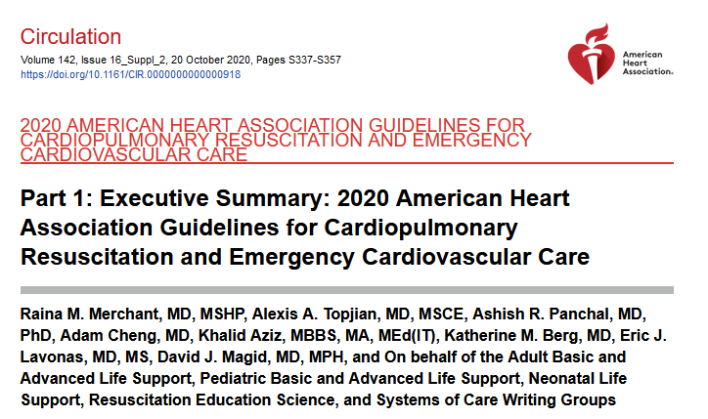
Circulation 142, Issue 16_Suppl_2, 20 October 2020, Pages S337-S357
https://doi.org/10.1161/CIR.0000000000000918

Slide 5
Levels of evidence
Only 12% based upon randomized trials
“The fact that only 6 of these 491 recommendations (1.2%) are based on Level A evidence (at least 1 high-quality randomized clinical trial [RCT], corroborated by a second high-quality trial or registry study) testifies to the ongoing challenges in performing high-quality resuscitation research. A concerted national and international effort is needed to fund and otherwise support resuscitation research.”
Level A
High-quality from more than 1 randomized trial (RCT) Meta-analyses of high-quality RCTs 1 or more RCTs corroborated by high-quality registry studies
Level B-R (randomized)
Moderate-quality evidence from 1 or more RCTs Meta-analyses of moderate-quality RCTs
Level B-NR (Non randomized)
Moderate-quality evidence from 1 or more well-designed, well-executed nonrandomized studies, observational studies, or registry studies Meta-analyses of such studies
Level C-LD (Limited data)
Randomized or nonrandomized observational or registry studies with limitations of design or execution Meta-analyses of such studies Physiological or mechanistic studies in humans
Level C-EO (Expert opinion)
Consensus of expert opinion based on clinical experience
Circulation 142, Issue 16_Suppl_2, 20 October 2020, Pages S337-S357
https://doi.org/10.1161/CIR.0000000000000918

Slide 6
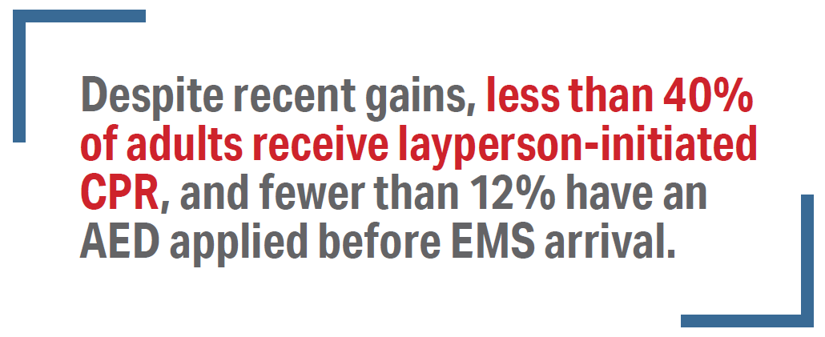
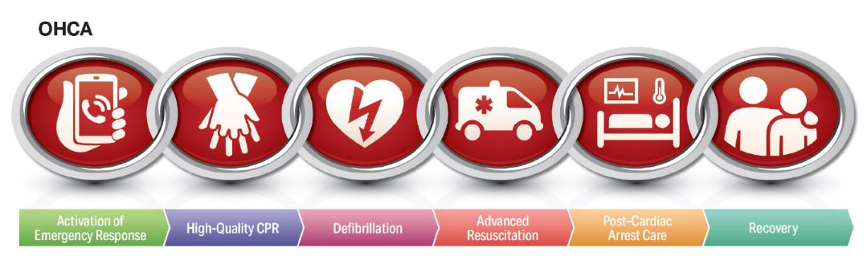
2020 Guidelines for Cardiopulmonary Resuscitation and Emergency Cardiovascular Care
Circulation 142, Issue 16_Suppl_2, 20 October 2020, Pages S337-S357
https://doi.org/10.1161/CIR.0000000000000918

Slide 7
Early Initiation of CPR by Lay Rescuers
2020 (Updated): We recommend that laypersons initiate CPR for presumed cardiac arrest because the risk of harm to the patient is low if the patient is not in cardiac arrest.
2010 (Old): The lay rescuer should not check for a pulse and should assume that cardiac arrest is present if an adult suddenly collapses or an unresponsive victim is not breathing normally. The healthcare provider should take no more than 10 seconds to check for a pulse and, if the rescuer does not definitely feel a pulse within that time period, the rescuer should start chest compression.
Circulation 142, Issue 16_Suppl_2, 20 October 2020, Pages S337-S357
https://doi.org/10.1161/CIR.0000000000000918
Notes:
Why: New evidence shows that the risk of harm to a victim who receives chest compressions when not in cardiac arrest is low. Lay rescuers are not able to determine with accuracy whether a victim has a pulse, and the risk of withholding CPR from a pulseless victim exceeds the harm from unneeded chest compressions.

Slide 8
Willingness to Perform Bystander CPR
2020 (New): It is reasonable to increase bystander willingness to perform CPR through CPR training, mass CPR training, CPR awareness initiatives, and promotion of Hands-Only CPR.
Circulation 142, Issue 16_Suppl_2, 20 October 2020, Pages S337-S357
https://doi.org/10.1161/CIR.0000000000000918
Notes:
Why: Prompt delivery of bystander CPR doubles a victim’s chances of survival from cardiac arrest. CPR training, mass CPR training, CPR awareness initiatives, and promotion of Hands-Only CPR are all associated with increased rates of bystander CPR.

Slide 9
2020 Guidelines for Cardiopulmonary Resuscitation and Emergency Cardiovascular Care
New link in the chain
Recovery
Circulation 142, Issue 16_Suppl_2, 20 October 2020, Pages S337-S357
https://doi.org/10.1161/CIR.0000000000000918

Slide 10
Care and Support During Recovery
2020 (New): We recommend that cardiac arrest survivors have multimodal rehabilitation assessment and treatment for physical, neurologic, cardiopulmonary, and cognitive impairments before discharge from the hospital.
2020 (New): We recommend that cardiac arrest survivors and their caregivers receive comprehensive, multidisciplinary discharge planning, to include medical and rehabilitative treatment recommendations and return to activity/work expectations.
2020 (New): We recommend structured assessment for anxiety, depression, posttraumatic stress, and fatigue for cardiac arrest survivors and their caregivers.
Circulation 142, Issue 16_Suppl_2, 20 October 2020, Pages S337-S357
https://doi.org/10.1161/CIR.0000000000000918
Notes:
Why: The process of recovering from cardiac arrest extends long after the initial hospitalization. Support is needed during recovery to ensure optimal physical, cognitive, and emotional well-being and return to social/role functioning. This process should be initiated during the initial hospitalization and continue as long as needed. These themes are explored in greater detail in a 2020 AHA scientific statement.

Slide 11
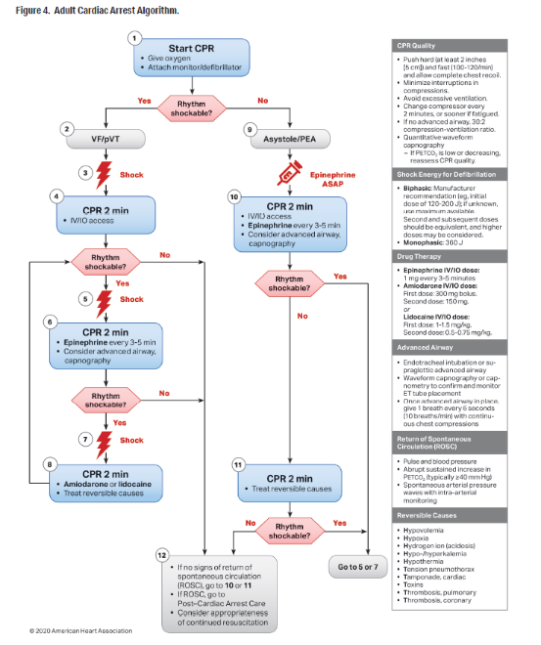
2020 Guidelines for Cardiopulmonary Resuscitation and Emergency Cardiovascular Care
Circulation 142, Issue 16_Suppl_2, 20 October 2020, Pages S337-S357
https://doi.org/10.1161/CIR.0000000000000918

Slide 12
Early Administration of Epinephrine
2020 (Unchanged/Reaffirmed): With respect to timing, for cardiac arrest with a nonshockable rhythm, it is reasonable to administer epinephrine as soon as feasible.
2020 (Unchanged/Reaffirmed): With respect to timing, for cardiac arrest with a shockable rhythm, it may be reasonable to administer epinephrine after initial defibrillation attempts have failed.
Circulation 142, Issue 16_Suppl_2, 20 October 2020, Pages S337-S357
https://doi.org/10.1161/CIR.0000000000000918
Notes:
Why: The suggestion to administer epinephrine early was strengthened to a recommendation on the basis of a systematic review and meta-analysis, which included results of 2 randomized trials of epinephrine enrolling more than 8500 patients with OHCA, showing that epinephrine increased ROSC and survival. At 3 months, the time point felt to be most meaningful for neurologic recovery, there was a nonsignificant increase in survivors with both favorable and unfavorable neurologic outcome in the epinephrine group.
Of 16 observational studies on timing in the recent systematic review, all found an association between earlier epinephrine and ROSC for patients with nonshockable rhythms, although improvements in survival were not universally seen. For patients with shockable rhythm, the literature supports prioritizing defibrillation and CPR initially and giving epinephrine if initial attempts with CPR and defibrillation are not successful.
Any drug that increases the rate of ROSC and survival but is given after several minutes of downtime will likely increase both favorable and unfavorable neurologic outcome. Therefore, the most beneficial approach seems to be continuing to use a drug that has been shown to increase survival while focusing broader efforts on shortening time to drug for all patients; by doing so, more survivors will have a favorable neurologic outcome.

Slide 13
Post–Cardiac Arrest Care and Neuroprognostication
The 2020 Guidelines contain significant new clinical data about optimal care in the days after cardiac arrest. Recommendations from the 2015 AHA Guidelines Update for CPR and ECC about treatment of hypotension, titrating oxygen to avoid both hypoxia and hyperoxia, detection and treatment of seizures, and targeted temperature management were reaffirmed with new supporting evidence.
In some cases, the LOE was upgraded to reflect the availability of new data from RCTs and high-quality observational studies, and the post–cardiac arrest care algorithm has been updated to emphasize these important components of care. To be reliable, neuroprognostication should be performed no sooner than 72 hours after return to normothermia, and prognostic decisions should be based on multiple modes of patient assessment.
Circulation 142, Issue 16_Suppl_2, 20 October 2020, Pages S337-S357
https://doi.org/10.1161/CIR.0000000000000918

Slide 14
Debriefings for Rescuers
2020 (New): Debriefings and referral for follow up for emotional support for
lay rescuers, EMS providers, and hospital-based healthcare workers after a cardiac arrest event may be beneficial.
Circulation 142, Issue 16_Suppl_2, 20 October 2020, Pages S337-S357
https://doi.org/10.1161/CIR.0000000000000918
Notes:
Why: Rescuers may experience anxiety or posttraumatic stress about providing or not providing BLS. Hospital-based care providers may also experience emotional or psychological effects of caring for a patient with cardiac arrest. Team debriefings may allow a review of team performance (education, quality improvement) as well as recognition of the natural stressors associated with caring for a patient near death. An AHA scientific statement devoted to this topic is expected in early 2021.

Slide 15
Data Registries to Improve
System Performance
2020 (New): It is reasonable for organizations that treat cardiac arrest patients to collect processes-of-care data and outcomes.
Out-of-hospital cardiac arrest:
Cardiac Arrest Registry to Enhance Survival (CARES) registry
A 2020 ILCOR systematic review found improvement in cardiac arrest survival in organizations and communities that participated in cardiac arrest registries.
Circulation 142, Issue 16_Suppl_2, 20 October 2020, Pages S337-S357
https://doi.org/10.1161/CIR.0000000000000918
Notes:
Why: Many industries, including healthcare, collect and assess performance data to measure quality and identify opportunities for improvement. This can be done at the local, regional, or national level through participation in data registries that collect information on processes of care (eg, CPR performance data, defibrillation times, adherence to guidelines) and outcomes of care (eg, ROSC, survival) associated with cardiac arrest.
Three such initiatives are the AHA’s Get With The Guidelines-Resuscitation registry (for IHCA), the AHA Cardiac Arrest Registry to Enhance Survival registry (for OHCA), and the Resuscitation Outcomes Consortium Cardiac Epistry (for OHCA), and many regional databases exist. A 2020 ILCOR systematic review found that most studies assessing the impact of data registries, with or without public reporting, demonstrate improvement in cardiac arrest survival in organizations and communities that participated in cardiac arrest registries.
Resuscitation Outcomes Consortium Cardiac registry
In-hospital cardiac arrest:
Get With The Guidelines-Resuscitation registry

Slide 16
Resuscitation Education
cpr.heart.org
Circulation 142, Issue 16_Suppl_2, 20 October 2020, Pages S337-S357
https://doi.org/10.1161/CIR.0000000000000918

Slide 17
Objectives:
Discuss changes to the 2020 American Heart Association Guidelines for Cardiopulmonary Resuscitation and Emergency Cardiac Care
Discuss the CARES Registry
Discuss the RAndomized Cluster Evaluation of Cardiac ARrest Systems trial

Slide 18

Cardiac Arrest Registry for Enhanced Survival
https://mycares.net
Notes:
Created 2004 agreement between CDC and Emory
Helps EMS Identify:
When, where, what part of the system is functioning properly, and where there are opportunities to improve
Creates single source of data from arrest to hospital discharge.
Quick and easy data collection
Track ongoing performance
Create reports for benchmarking
Provides EMS with patient disposition.
Data will influence cardiac arrest survival throughout the world.
CARES is the tool used for data collection.
Use of CARES is free to RACE CARS participants.
NC now has over 20,000 patient in CARES since 2010

Slide 19
CARES Registry
The Cardiac Arrest Registry to Enhance Survival (CARES) registry.
  Is a voluntary, prospective clinical registry of patients with cardiac arrest in the U.S.
  24 states and 61 cities covering 106 million people.
Innovative aspect of the trial is the use of the existing data collection system, CARES registry.
  All OHCAs, of cardiac etiology, in each randomized county will enrolled in our trial.
  Primary and secondary outcomes will be exclusively collected in CARES.
Over the past 10 years, we have worked to increase the coverage of the CARES registry in NC.
  57/100 counties collecting CARES data (911 dispatchers, EMS agencies, and hospitals).

Slide 20
Data Collected
Basic Demographics
Basic Incident /Response Details
Arrest Details
CPR Details
AED Usage
EMS Interventions
Outcome

Slide 21
CARES Data Elements
911 dispatch, EMS, hospital data elements

Slide 22
How Does It Work
Web based – https://mycares.net
EMS enters their data
System notifies hospital to add their data
Data is audited and corrected as needed
De-identified (name & DOB removed from record)

Slide 23
Patient Criteria for EMS
Sudden cardiac arrest of non-traumatic etiology:
  EMS must preform CPR
    Or
  The patient is defibrillated by AED or manually
  Excluded:
    Traumatic cardiac arrest
    Arrest terminated immediately by EMS because signs of death or injuries incompatible with life.
    Inter-facility transfers
    Events originating outside 911 system (i.e. private or non-emergency transports)
    By-stander CPR cases with a pulse upon 911 arrival
    DNR patients removed from survival calculations
    Patient is able to refuse service on scene

Slide 24
Patient Criteria for Hospital Data
Any non-traumatic arrest
  Only cardiac etiology prior to January 2013
Ongoing resuscitation in ED
Notes:
Ongoing resuscitation means that the patient is still receiving treatment and not deceased. Does not mean still receiving CPR.

Slide 25
CARES Dispatch Module Elements

Slide 26
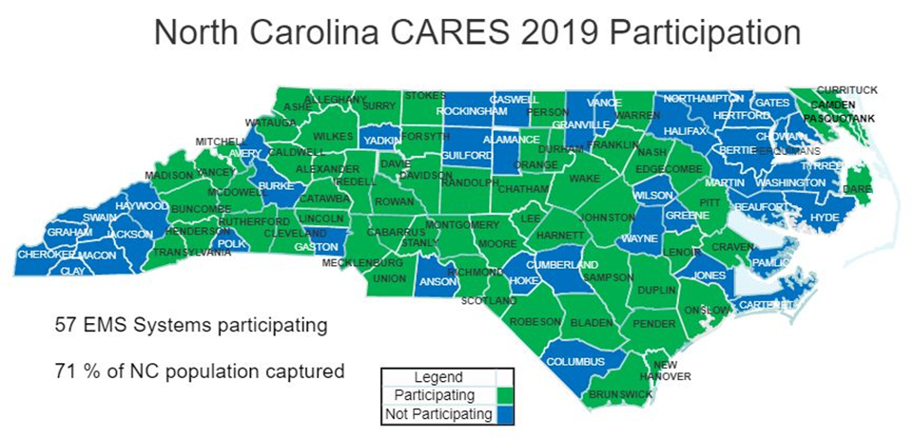
Notes:
When program started only 3 systems reported into CARES Durham, Mecklenburg and Wake.
Systems may still join. Request application from Clark Tyson clark.tyson@duke.edu

Slide 27
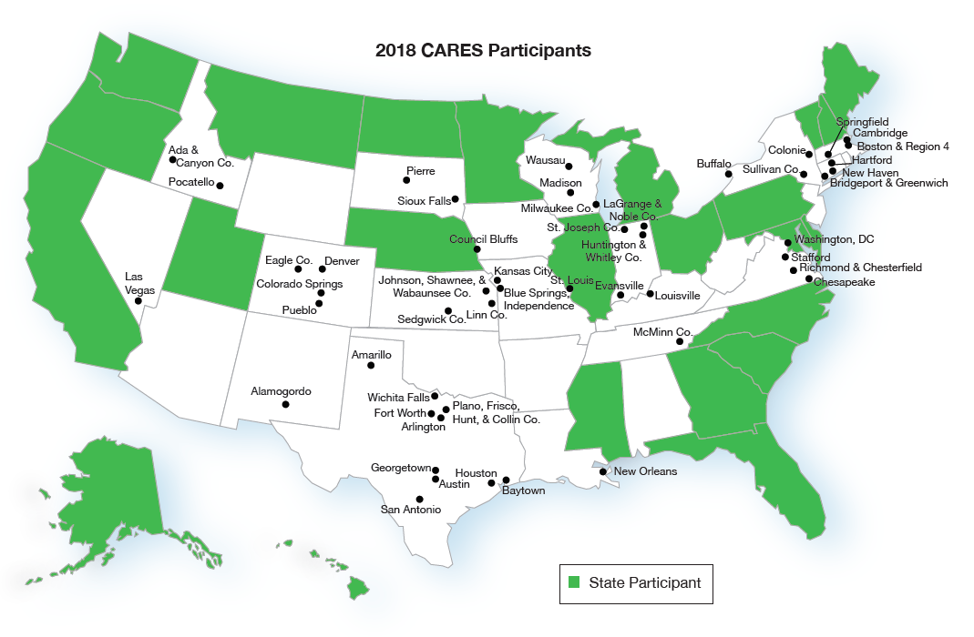
CARES Participation

Slide 28
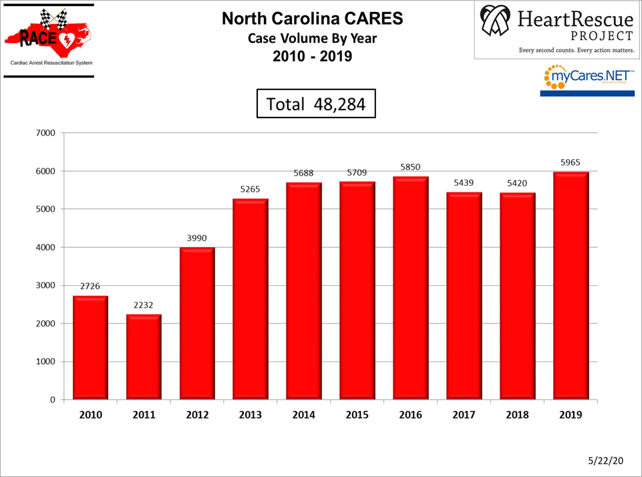

Slide 29
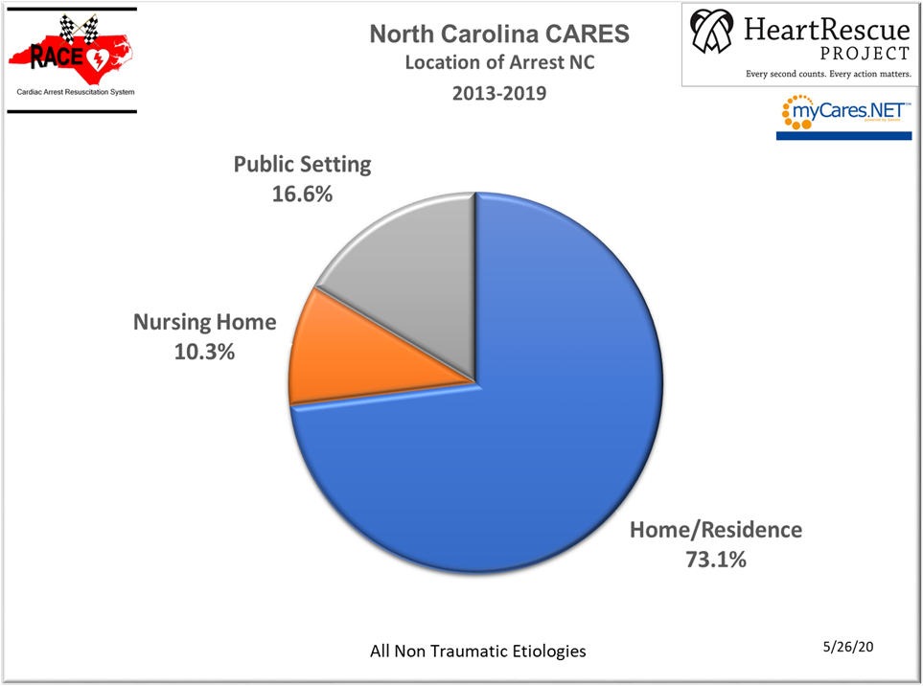
Notes:
Take away- To make a major impact on survival rates we need to make sure that our interventions are effective in the home environment.
Public Setting interventions are very important but we must find effective ways to improve bystander CPR rates and reduce time to CPR and defibrillation in the home setting.
Dispatch assisted CPR and hospital provided hands only CPR instruction to family members of cardiac patients are two examples of programs intended to improve bystander CPR rates in the home.

Slide 30
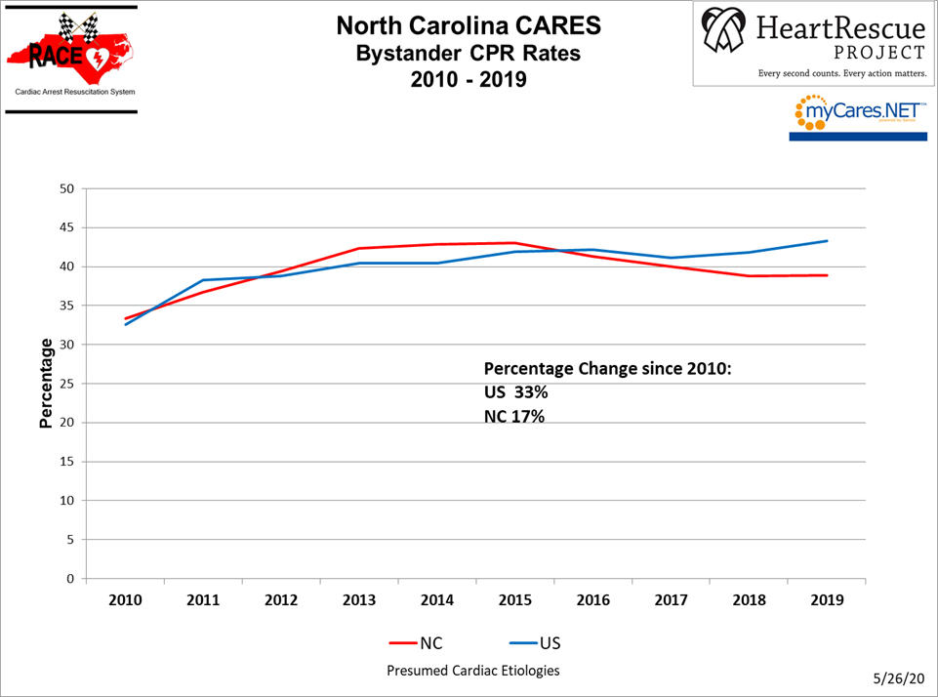

Slide 31
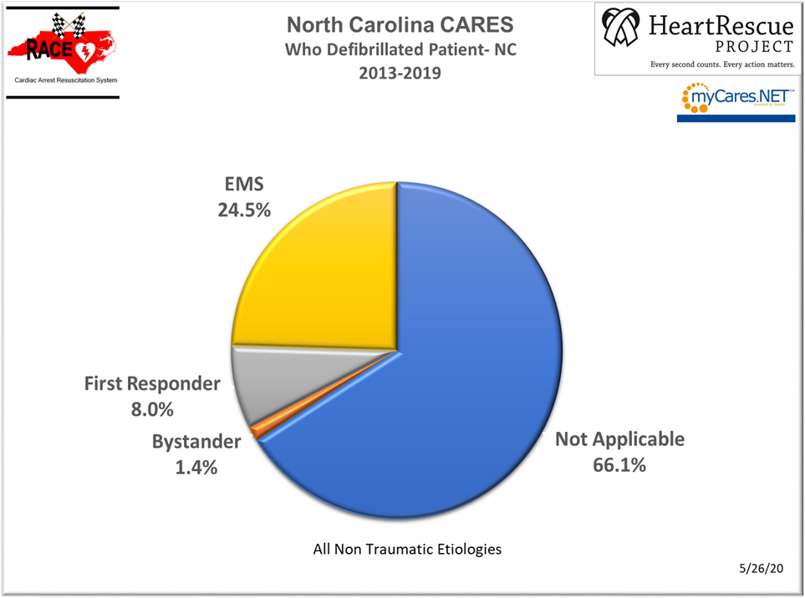

Slide 32
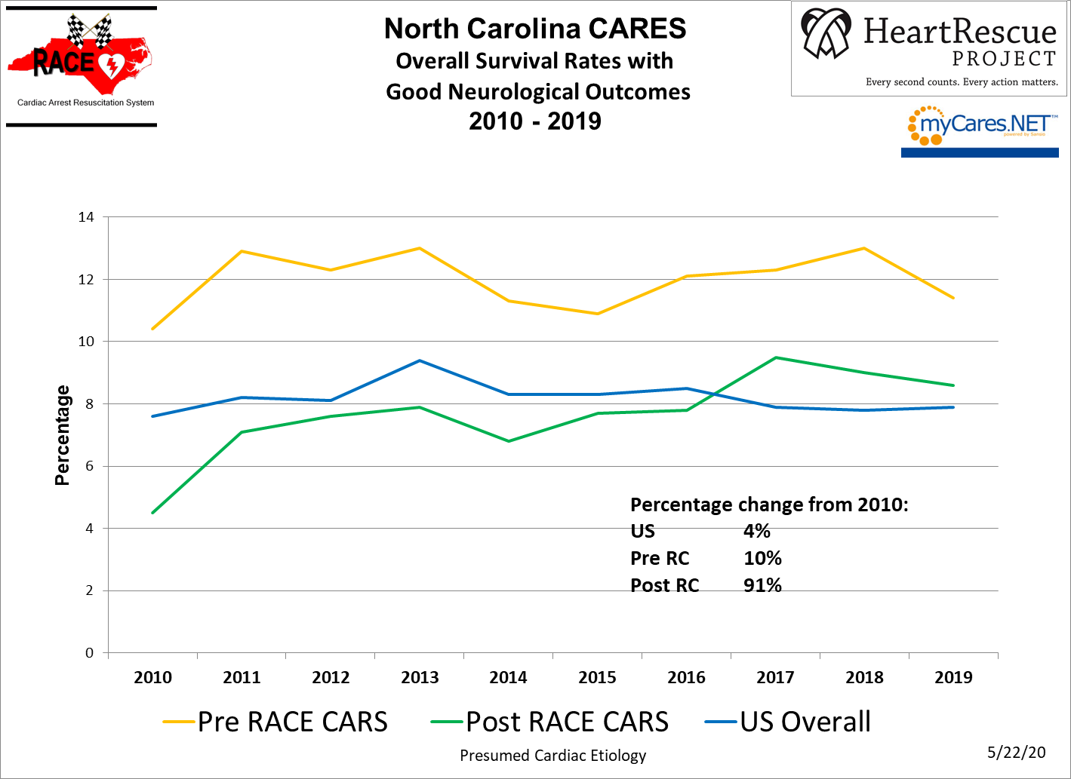
Notes:
The Pre-RACE CARS group are the 4 NC agencies reporting into CARES as of 1/1/2010. The Post RACE CARS group are those NC agencies that have joined CARES after the start of the RACE CARS Project 3rd Qtr. 2011

Slide 33
Objectives:
Discuss changes to the 2020 American Heart Association Guidelines for Cardiopulmonary Resuscitation and Emergency Cardiac Care
Discuss the CARES Registry
Discuss the RAndomized Cluster Evaluation of Cardiac ARrest Systems trial

Slide 34
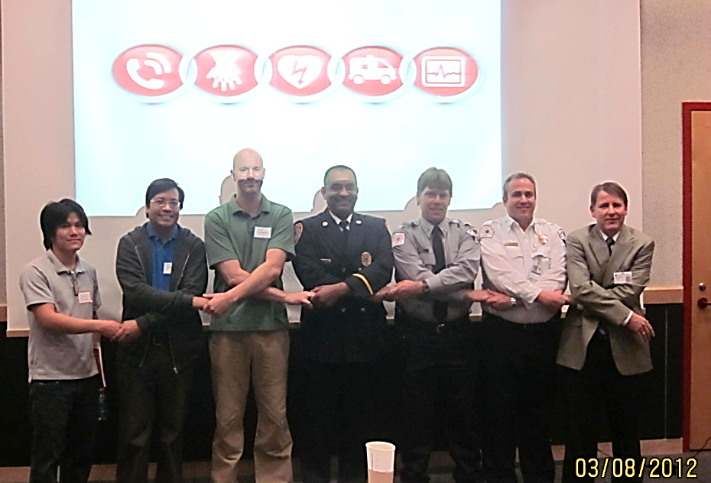
Objectives
Provide RACE CARS Trial Overview
Answer Agency Questions about the Trial
Discuss Next Steps

Slide 35
Introduction
Approximately 350,000 OHCA/year
Only 8% to 10% survive
Nationally, < 40% of patients receive bystander CPR
29% have an AED applied prior to paramedic arrival
>70% of patients do not receive timely defibrillation
911 call to paramedic arrival >7 minutes
30 years of work, little evidence that these statistics have improved

Slide 36
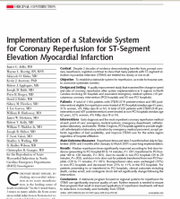
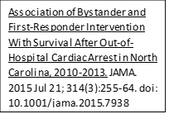
History on North Carolina RACE
“AHA’s Mission: Lifeline – A Call to Arms for Emergency Medicine” ACEP News Jan 2009
“RACE: A Herculean attempt to improve STEMI care”
Nov 12, 2007 Lisa Nainggolan
“AHA’s Mission: Lifeline – A Call to Arms for Emergency Medicine” ACEP News Jan 2009
Mission Lifeline
RACECARS
Implementation
Study
IMPROVE
Stroke
RACE CARS
Trial
RACE Pilot
1st STEMI
System
RACE
65 hospitals/
Multiple EMS
Agencies
RACE - ER
Entire State
2003 2005-2007 2007-2009 2010-2015 2016-2021 2020-2027
“RACE moved beyond the cath lab and PCI hospitals to focus on EDs, EMS, hospital networks, and associated communication and transport systems.” Heart.org
“North Carolina’s RACE program cuts door-in door-out times for STEMI patients”
Jun 28, 2011 Reed Miller
“Racing Against the Clock: A North Carolina-based project becomes a model for discovery-to-balloon” Richard R. Rogoski 2008
  RACE observed:
    25% increase in bystander CPR and first responder defibrillation
    37% increase in survival with good neurologic function
  NC statewide data continue to demonstrate substantial variability for OHCA.
Notes:
In NC, we have worked for 15 years on overcoming fragmentation for acute cardiac emergencies.
RACE began in 2005
a coordinated statewide approach to improve emergency cardiovascular care
focused on overcoming systematic barriers impeding timely and effective care.
In 2010, RACECARS was extended to OHCA.
RACE pilot tested the implementation of key OHCA interventions
RACE observed:
25% increase in bystander CPR and first responder defibrillation
37% increase in survival with good neurologic function
NC statewide data continue to demonstrate substantial variability for OHCA.

Slide 37
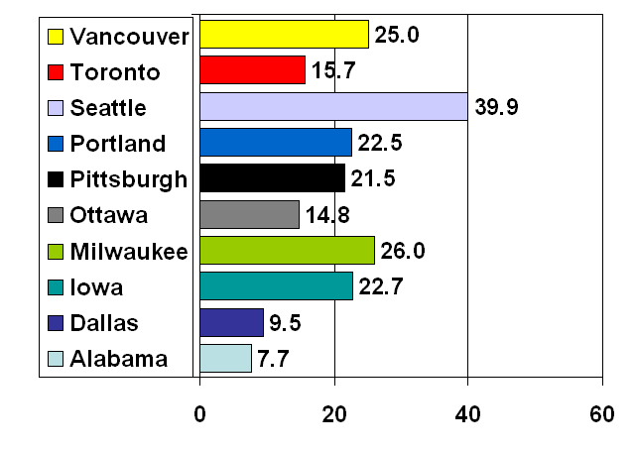
Variation in survival VF arrest
Resuscitations Outcomes Consortium
Survival to discharge
“Where you live
should not determine
whether you live”
Nichol JAMA. 2008;300(12):1423-1431
Notes:
Context The health and policy implications of regional variation in incidence and outcome
of out-of-hospital cardiac arrest remain to be determined.
Objective To evaluate whether cardiac arrest incidence and outcome differ across
geographic regions.
Design, Setting, and Patients Prospective observational study (the Resuscitation
Outcomes Consortium) of all out-of-hospital cardiac arrests in 10 North American sites
(8 US and 2 Canadian) from May 1, 2006, to April 30, 2007, followed up to hospital
discharge, and including data available as of June 28, 2008. Cases (aged 0-108 years)
were assessed by organized emergency medical services (EMS) personnel, did not have
traumatic injury, and received attempts at external defibrillation or chest compressions
or resuscitation was not attempted. Census data were used to determine rates
adjusted for age and sex.
Main Outcome Measures Incidence rate, mortality rate, case-fatality rate, and survival
to discharge for patients assessed or treated by EMS personnel or with an initial
rhythm of ventricular fibrillation.
Results Among the 10 sites, the total catchment population was 21.4 million, and there
were 20 520 cardiac arrests. A total of 11 898 (58.0%) had resuscitation attempted; 2729
(22.9% of treated) had initial rhythm of ventricular fibrillation or ventricular tachycardia
or rhythms that were shockable by an automated external defibrillator; and 954 (4.6%
of total) were discharged alive. The median incidence of EMS-treated cardiac arrest across
sites was 52.1 (interquartile range [IQR], 48.0-70.1) per 100 000 population; survival
ranged from 3.0% to 16.3%, with a median of 8.4% (IQR, 5.4%-10.4%). Median ventricular
fibrillation incidence was 12.6 (IQR, 10.6-5.2) per 100 000 population; survival
ranged from 7.7% to 39.9%, with a median of 22.0% (IQR, 15.0%-24.4%), with significant
differences across sites for incidence and survival (P.001).
Conclusion In this study involving 10 geographic regions in North America, there
were significant and important regional differences in out-of-hospital cardiac arrest
incidence and outcome.
JAMA. 2008;300(12):1423-1431

Slide 38
Time to defibrillation, who did it, and survival
Hansen C, et al. JAMA.2015;314:255-264

Slide 39
RACE CARS Rationale
Main barrier preventing progress is not the lack of knowledge but the effective systematic implementation of what works.
The greatest opportunity for improving cardiac arrest outcomes is an intensified strategic focus on:
  improved 911 recognition of OHCA and delivery of telephone CPR
  more rapid deployment of first responder defibrillation
  improved use of bystander CPR

Slide 40
RACE-CARS Trial Design

Slide 41
RACE-CARS Trial Leadership
Dr. Christopher Granger, is the principal investigator of the clinical coordinating center
Dr. Hussein Al-Khalidi and Dr. Daniel B. Mark are the PIs of the data coordinating center.
Other DCRI investigators include Drs. James Jollis, Monique Starks, Sana Al-Khatib
RACE-CARS Staff: Lisa Monk MSN, RN, CPHQ and Clark Tyson, MA
Team of researchers at the Duke Clinical Research Institute in partnership with:
  EMS agencies
  Hospitals
  911-dispatch
  Fire rescue
  Law enforcement agencies
  Communities groups
Notes:
I would keep the traditional format for how the trial leadership is arranged. While the health systems are critical the trial is being conducted by Duke

Slide 42
RACE CARS Trial Objectives
Primary Objective:
  Improve survival to hospital discharge with good neurologic function by 33% from 9.0% to 12.0%
Secondary Objectives:
  Increase bystander rates of CPR in intervention counties by 33% compared with control counties
  Increase rates of bystander or first responder defibrillation prior to paramedic (emergency medical provider trained in advanced cardiac resuscitation) arrival in intervention counties by 50% compared to control counties.

Slide 43
Long-Term Outcomes Study
Assessment of QOL and functional status at 3-6 and 12 months using validated scales.
  Approximately 2100 survivors
  EMS coordinators will obtain contact information and send out the Opt Out letter
  DCRI Call Center will contact patient
  EMS will assist in resolving any contact information issues
Will obtain waiver of written informed consent to conduct phone surveys
Notes:
Monique to do

Slide 44
Implementation Study
Assessment of EMS agencies, 911 dispatch, fire/police, and community
  Assessment of interventions that were implemented
  Assessment of how interventions contributed to outcomes
  Plan for key stakeholder interviews and surveys at baseline and conclusion (and at other time points during trial conduct)

Slide 45
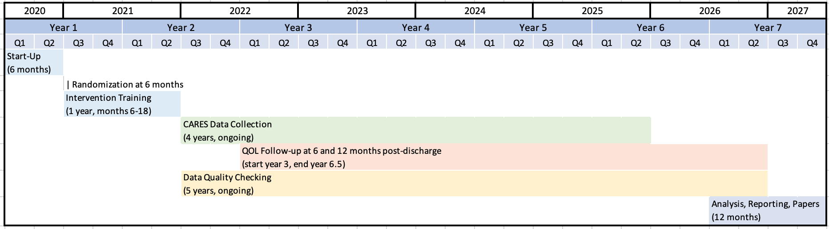
Trial Duration and Components
Notes:
I

Slide 46
Participating EMS Agencies
Requirements by Randomization
Arm
Intervention (Enhanced Care)
Timely CARES Data Entry
Recruitment of Strategic Partners for interventions
Recruitment of Cardiac Arrest Survivors for Long-Term Follow-Up
Conduct interventions around improving bystander CPR and AED usage
Interaction with the RACE CARS Team
Control (Usual Care)
Timely CARES Data Entry
Continue current EMS and first responder practices
Usual care practice for duration of trial
Recruitment of Cardiac Arrest Survivors for Long-Term Follow-Up

Slide 47
Participating 911 Center Requirements by Randomization Arm
Intervention (Enhanced Care)
  Enter data into the CARES dispatch module
  Participate in education
  Participate in quarterly audits
  Participate in QA efforts
  Interact with the RACE CARS Team
Control (Usual Care)
No change in dispatch procedures during study period
Submit recording of 10% of cardiac arrest events for study review

Slide 48
CARES Data Use in RACE-CARS
Primary Data Collection for the Trial
Customization of Intervention
Feedback and Intervention
Primary Contact for Long-Term Follow-up
RACE-CARS public reports, presentations, and papers will present only aggregate data.
No individual county data will ever be released or made public in any way by the RACE-CARS team.
Permission for RACE CARS Team to see county level data.

Slide 49
Institutional Review Board
Will seek waiver of informed consent for primary outcome
  Most of the data required for the trial are already being collected by the CARES registry for QI purpose with informed consent
  Our trial is testing quality improvement strategies to promote uptake of recommended community interventions (minimal risk intervention)
  The risk to patients whose data will be collected routinely (with or without participation in the trial) is not increased beyond what would be routinely encountered (minimal risk).
Trial will not be subject to “EFIC” Regulations
  No investigational devices and FDA products used according to guideline indications
  Control Group receiving Standard of Care.
Will seek informed consent for secondary outcomes (verbal)
  Long-term Follow-up Study
  Implementation Study
Notes:
EFIC- Exception from Informed Consent- FDA regulation that allows for the conduct of trial under emergency conditions without informed consent. Requires community consultation and obtaining consent as soon after the cardiac arrest as feasible. Our study is receiving a waiver for IC under NIH rules for minimal risk trials.

Slide 50
Next Steps- Deadline 2/15/21
Next steps for EMS:
  Agree to collect CARES registry data
  confirm with 911 that they will participate
  email me your decision to participate and copy the 911 contact
  if participating, include the legal contact email address for both EMS and 911(if applicable)
Next steps for the RACE CARS Team:
  share the protocol and IRB once approved
  randomization of sites in January
  begin contract work with sites once they have been randomized

Slide 51
RACE-CARS Contacts
Lisa Monk lisa.monk@duke.edu
Clark Tyson clark.tyson@duke.edu

Slide 52
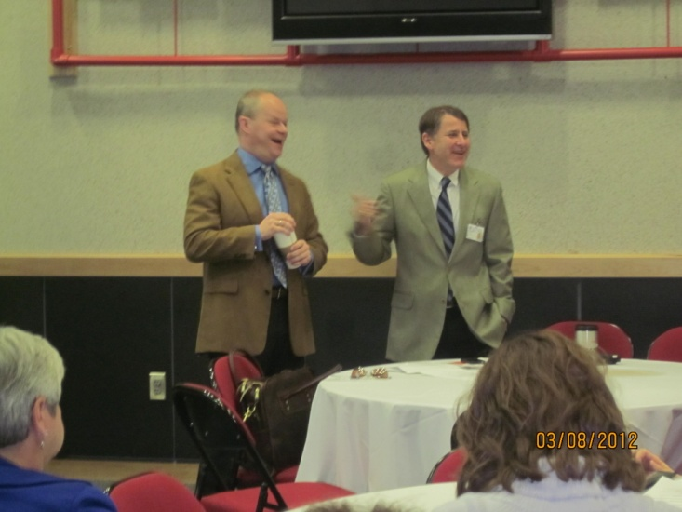


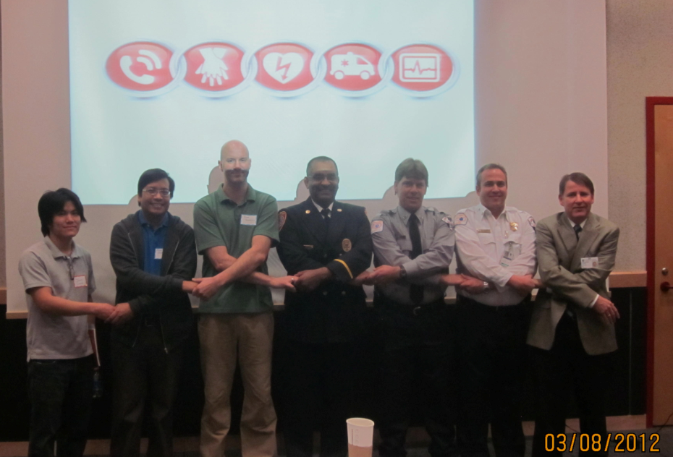
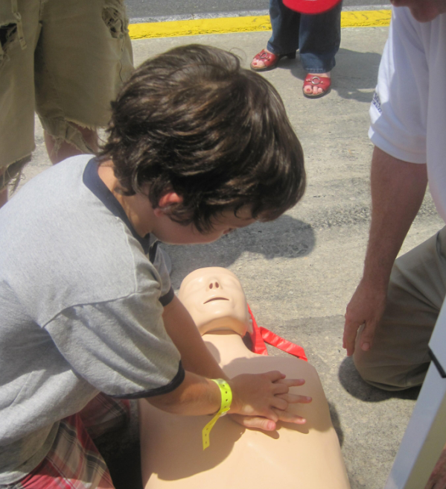
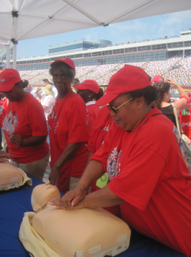

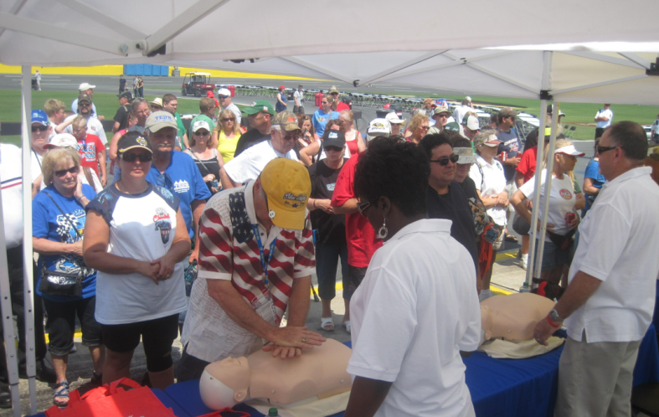


Slide 53

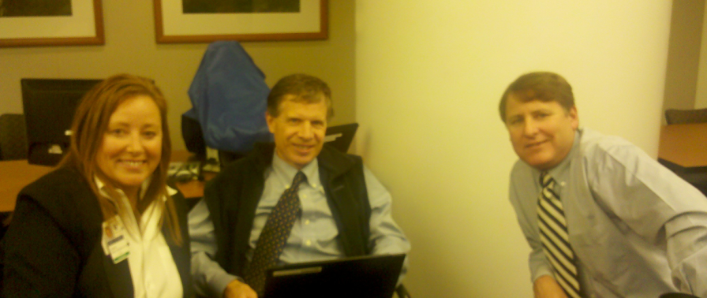
Let’s make NC
the best place to have a
CARDIAC ARREST!

